Slide 1
Arrays in C#
- By Pramit Saha

Slide 2
What is an Array?
Array are the homogeneous(similar) collection of data types.
Array Size remains same once created.
Simple Declaration format for creating an array
type [ ] identifier = new type [integral value];

Slide 3
Array Notation in C#
You declare an array variable by specifying:
The element type of the array.
The rank of the array.
The name of the variable
type[ ] name;
This specifies the name of the array variable
This specifies the rank of the array
This specifies the element type of the array

Slide 4
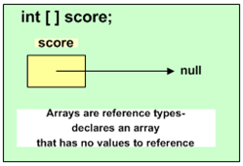
Array Declaration

Slide 5
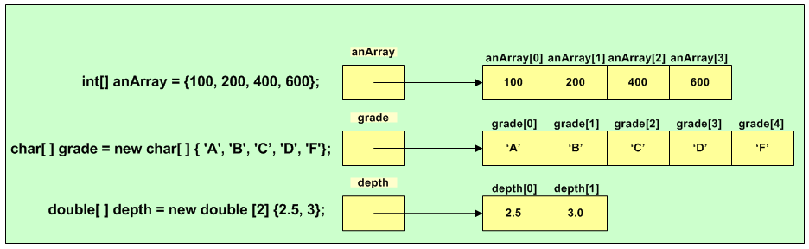
Array Initialization
Methods of creating and initializing arrays at compile time

Slide 6
Types of Array
Array
Single Dimensional Array
Multi-Dimensional Array
Jagged Array

Slide 7
Single-Dimensional Array
The one dimensional array or single dimensional array in C# is the simplest type of array that contains only one row for storing data.
Declaration: double[] balance = new double[10];

Slide 8
Declaration of 1D Array
int [] marks = new int[2] { 99, 98, 92, 97, 95}; int[] score = marks;

Slide 9
Multi-Dimensional Array
Multi-dimensional arrays are also called rectangular array.
Stored sequentially.
It contains more than one rows.
Declaration: type[,] array = new type[9, 9];
array[3,8] = 100;

Slide 10
Declaration of Rectangle Array
string[,] array2Db = new string[3, 2]
{ { "one", "two" }, { "three", "four" }, { "five", "six" } };

Slide 11
Jagged array
A jagged array is an array whose elements are arrays.
The elements of a jagged array can be of different dimensions and sizes.
Declaration:
int[][] jaggedArray = new int[3][];

Slide 12
Declaration of Jagged Array
int[][,] jagged = new int[3][,]
{ new int[,] { {1,3}, {5,7} },
new int[,] { {0,2}, {4,6}, {8,10} },
new int[,] { {11,22}, {99,88}, {0,9} } };

Slide 13
Thank You

